Slide 1

C Programming Language
CHARACTER SET
www.btechsmartclass.com

Slide 2
What is C Character set?
C Character set is a collection of characters supported in C programming language.
C Programming language has a rich set of characters which are used to construct c program instructions.
1

Slide 3
What does C Character Set contains?
Alphabets
- C Language supports all alphabets of English. It supports both UPPERCASE & lowercase letters
Digits
- C Language supports 10 digits to construct numbers. Those 10 digits are 0,1,2,3,4,5,6,7,8,9
Special Symbols
- C supports a rich set of special symbols that include symbols to perform mathematical operations, condition checking, white space, back space, etc…
2

Slide 4
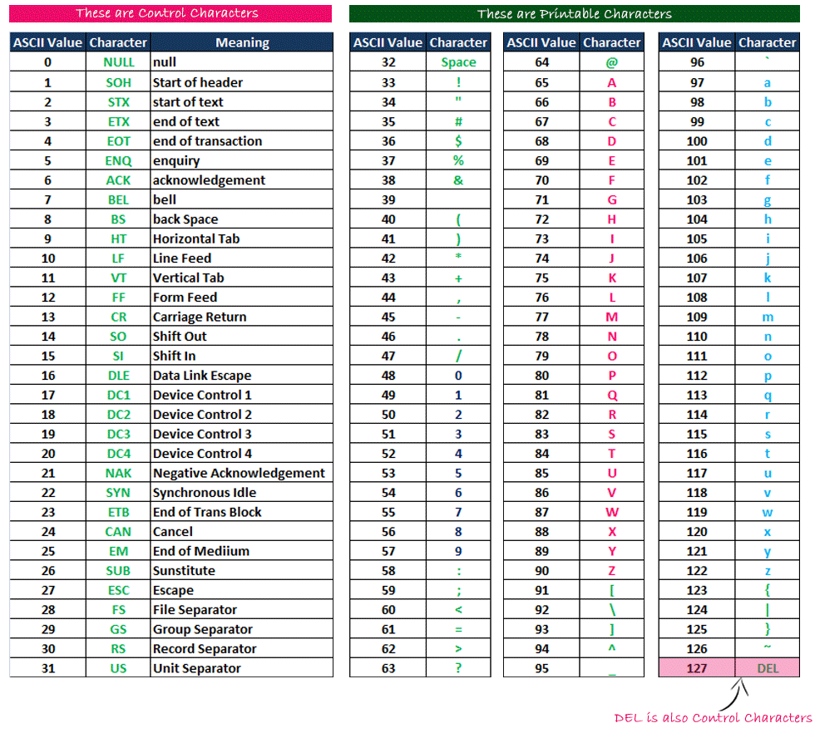
Commonly used Special Symbols with ASCII Values
3

Slide 5
Note
- In C Programming Language, the character set follow ASCII (American Standard Code for Information Interchange) code text format.
- Every character in C language has the respective ASCII value which is used to convert a character into Binary language.
4

Slide 6


For more information please visit www.btechsmartclass.com
Please do subscribe my channel

